Slide 1
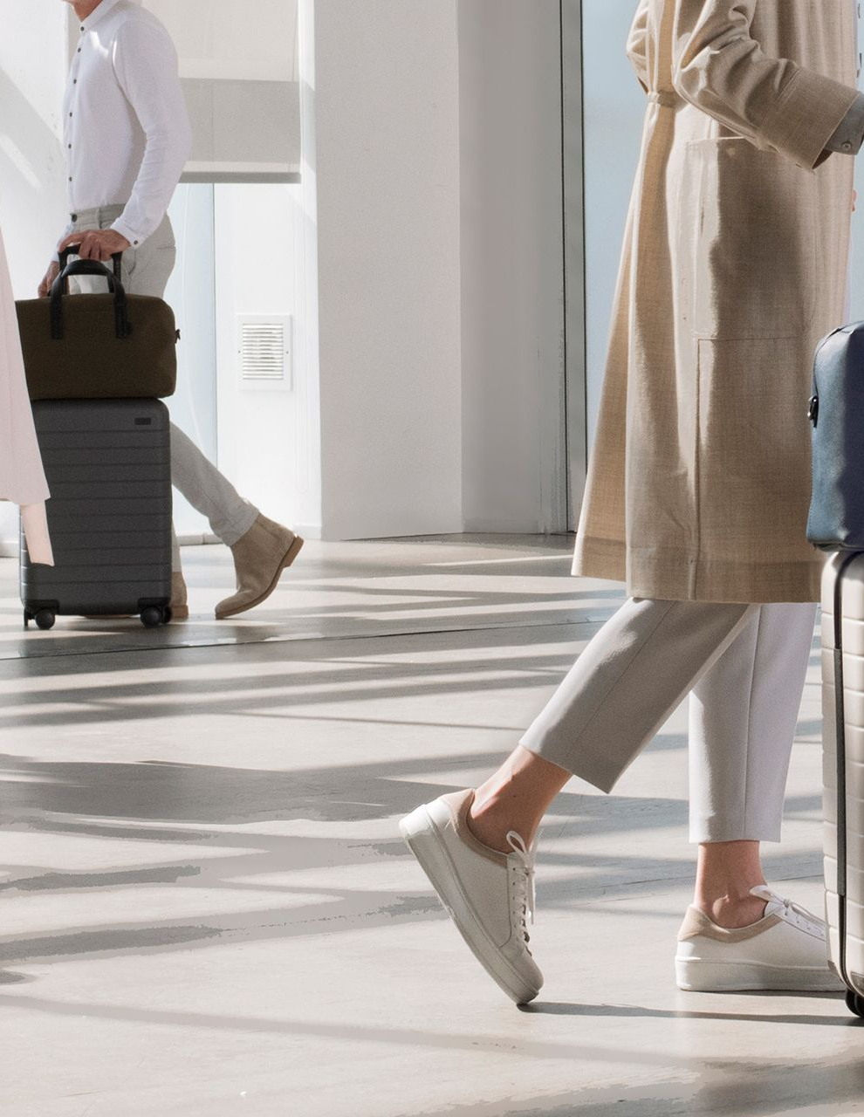

Away Travel: A Troubling Case
Jinhong Brejnholt

Slide 2
Away Travel: A Troubling Case
Focus on question 2:
Diagnose Steph Korey’s leadership style, using examples from the case, and theories of leadership. What leadership style do you think is most appropriate for a company like Away, and what impact do you think this would have had on the company’s success? Support your answer using your own research.

Slide 3
Agenda
Steph Korey’s Leadership Style
Recommend the most suitable leadership style for Away
Assess impact on company success

Slide 4

Steph Korey’s Leadership Style
Transactional Leadership
Authoritarian (Autocratic) Leadership
Toxic Leadership Traits

Slide 5

Enforced strict communication rules
Public shaming on Slack ("brain dead")
Denied PTO unless KPIs were met via random checks
Firing marginalized employees for expressing grievances
Source: Emotional baggage
Notes:
Enforced strict communication rules (no email, limitedprivate messages)
Public shaming on Slack ("brain dead" remark)
Denied PTO unless KPIs were met via random checks
Firing marginalized employees for expressinggrievances hot-topic slack channel

Slide 6

Theoretical Lens
Transactional Leadership
Focus on performance & compliance
Rewards/punishments, rigid goals
Authoritarian/Autocratic Leadership
Unilateral decision-making
Suppression of dissent
Toxic Leadership
Manipulation masked as empowerment
Psychological harm to employees

Slide 7
Short-Term
Explosive growth ($1.4B valuation)
Strong brand buzz & market penetration
Long-Term
Employee burnout and resignations
Public scandal, 90% drop in sales
Departure of co-founders and leadership vacuum
Source:
Inc. article by Tim Crino (2021)
NYT interview with Korey
Consequences for Away

Slide 8
What Leadership Style Would Work Better?
Crafting an engaging, impactful, and professional presentation

Slide 9

Recommended: Transformational + Servant Leadership

Slide 10

Transformational + Servant Leadership?
Why?
Aligns with Away's brand of inclusivity & empowerment
Promotes sustainable culture, employee well-being
Builds trust, innovation, and long-term success

Slide 11

Example
Jen Rubio as interim CEO
Wellness days, gender-neutral leave, transparency
Regular check-ins & open communication

Slide 12
Summary
Leadership Style | Impact at Away
Korey's Authoritarian | Fast growth, toxic culture, PR disaster
Rubio's Transformational | Rebuilding trust, sustainability, inclusivity
Lesson: culture must match brand. Leadership sets the tone.

Slide 13
Final Thoughts
Steph Korey's case is a cautionary tale
Leadership style affects not just performance, but brand identity
Culture-driven leadership is key for modern, purpose-driven companies
Notes:
Shareholder benefits

Slide 14
Reference
Burns, J. M. (1978). Leadership
Bass, B. M. (1985). Leadership and Performance Beyond Expectations DOI
Greenleaf, R. (1970). The Servant as Leader Greenleaf Center
How to Lead: 6 Leadership Styles and Frameworks
What is Autocratic Leadership
How to Become a Transformational Leader
The Verge article on Away
Inc. article on turnaround
NYT on Korey's return

Slide 15
Thank You
Jinhong Brejnholt

